Slide 1

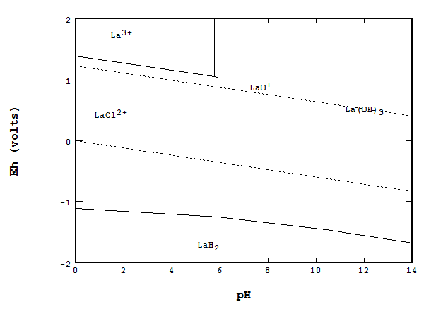
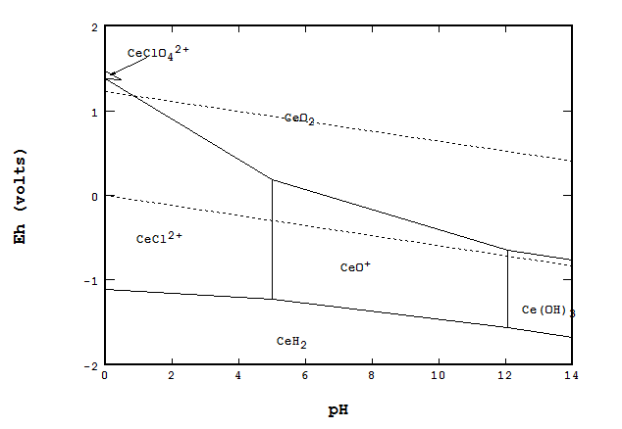
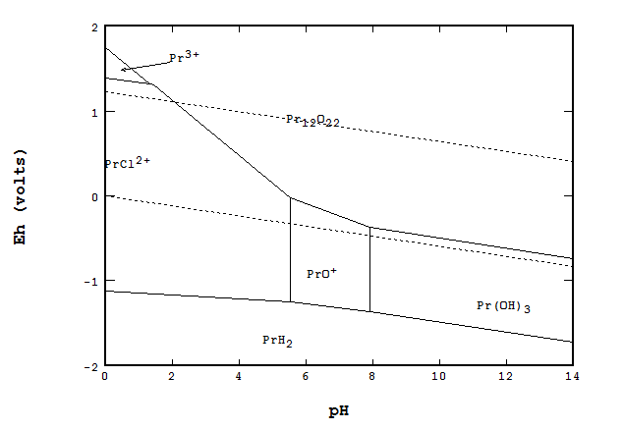
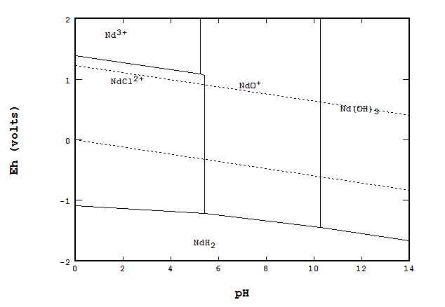
Solvent Extraction and Separation of the Light Rare Earth Elements La, Ce, Pr, and Nd
Emily Byers (Smith College)
Faculty Advisor: Dr. M. Sadegh Safarzadeh
Introduction
Results
Experimental
Rare Earth elements (REEs) used in many industrial applications
China provides ~95% of world’s supply, but recently began restricting the market exports
Need to develop domestic extraction and purification methods that are industrially viable
Aim to study effects of key parameters on extraction and gain better understanding of the extraction reaction
Leach carbonate precipitate of Mountain Pass Bastnasite ore in 1M HCl
Dilute 5x and adjust pH of aqueous leach solutions
Perform solvent extraction
Analyze using ICP-MS and titration
Extraction Process
Project Goals
Identify distribution ratios of LREEs La, Ce, Pr, and Nd in chloride solutions using different conditions
Observe %E of LREEs from chloride solutions
Study stoichiometry of extraction reaction
Identify ideal separation conditions
Study speciation of LREEs in chloride solutions
Calculate the separation factors
Contribute to the development of efficient, industrially viable solvent extraction separation process
Organic Phase
Solvent Extraction
Organic Phase
Aqueous Phase
Aqueous Phase
  M^{n+} + nRH <=> MR_{n} + nH⁺
Extractant | [Extractant] | O/A ratio | Equilibrium pH | Initial pH | Δ pH
Cyanex 272 | 30% | 1 | 1.34 | 1.49 | 0.15
Cyanex 272 | 30% | 2 | 1.26 | 1.49 | 0.23
Cyanex 272 | 50% | 1 | 1.38 | 1.49 | 0.11
Cyanex 272 | 50% | 2 | 1.26 | 1.49 | 0.23
Cyanex 572 | 30% | 1 | 0.802 | 1.43 | 0.63
Cyanex 572 | 30% | 2 | 1.08 | 1.43 | 0.35
Cyanex 572 | 50% | 1 | 1.11 | 1.43 | 0.32
Cyanex 572 | 50% | 2 | 1.04 | 1.43 | 0.39
pH=1, 2
O/A=1:1, 2:1
C_{org}=30%, 50%
Cyanex 272 and 572 in kerosene
Run extractions 15 minutes, 25 ºC, 300 rpm
Extractants
Conclusions
Cyanex 272
  bis(2,4,4-trimethylpentyl)phosphinic acid
  Cationic extractant
  Potential for effective separation of Pr and Nd from La in literature
Trends:
  Decrease in %E of Ce with increased concentration of Cyanex 272
  ~10% increase in %E for each LREE with increased concentration of Cyanex 572
  In general: %E of Nd>Pr>La or Ce
Cyanex 572 more effective at extracting LREEs than Cyanex 272
Cyanex 272
Future Work
Cyanex 572
  New chelating extractant
  Not reported in the open literature
  Originally designed for heavy REEs
Precipitate Ce prior to solvent extraction
Examine equilibrium pH and connection to stoichiometry of extraction reaction
Attempt to separate Nd and Pr from La, then precipitate Pr
E_{h}-pH diagrams for (La, Ce, Pr, Nd)-Cl-H₂O systems, 25 ºC
[La]=6.2 mg/L , [Ce]=10.4 mg/L, [Pr]=1.2 mg/L, [Nd]=3.3 mg/L, [Cl⁻]=1 mol/L
Acknowledgements:
Dr. M Sadegh Safarzadeh, Dr. Michael West, Dr. Alfred Boysen, Russ Lingenfelter, Loren Berry, Ceren Bozbay
This work was made possible by the National Science Foundation REU Back to the Future, Site DMR-1157074

