Slide 1
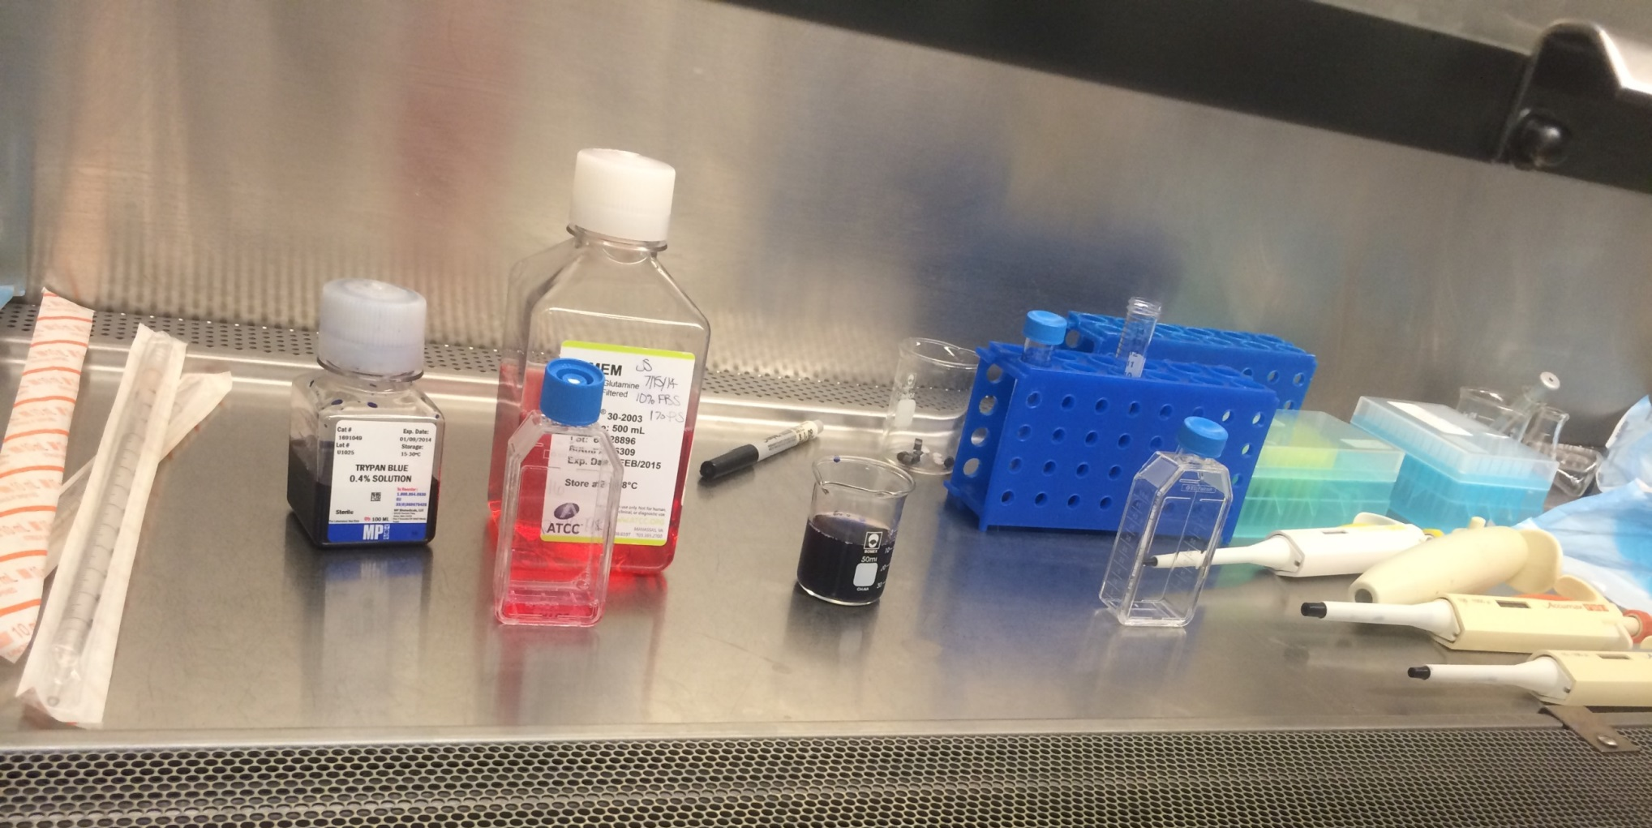
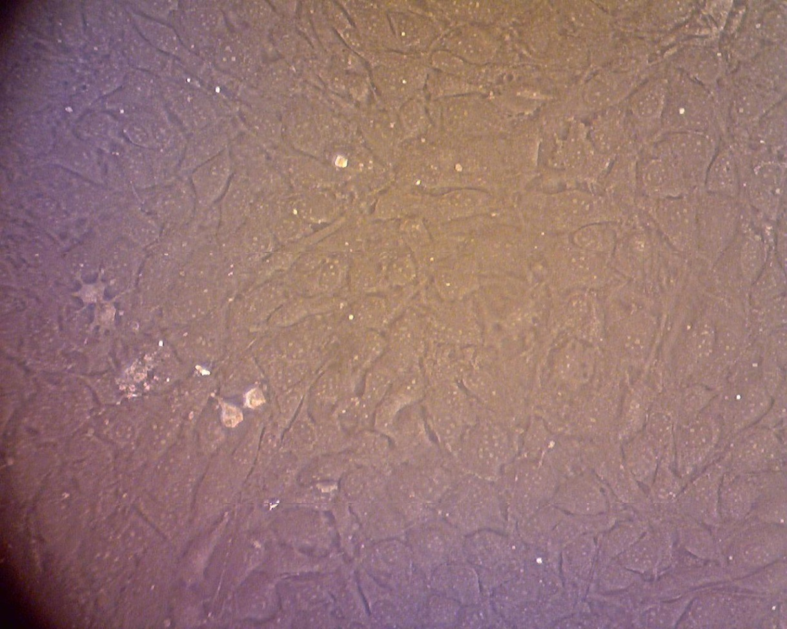
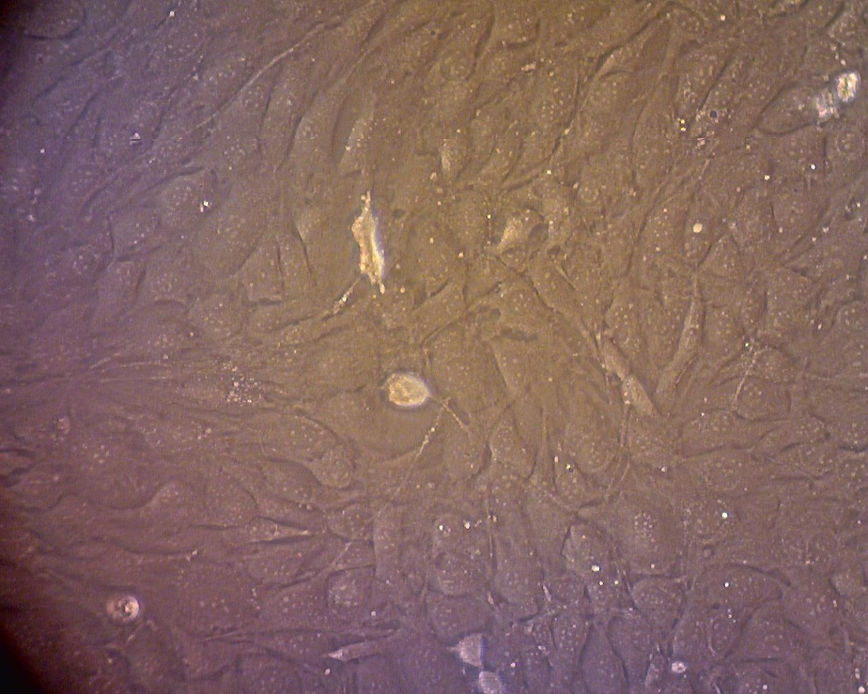
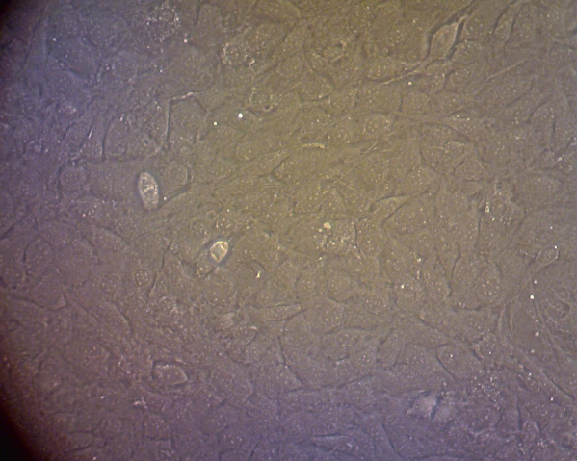
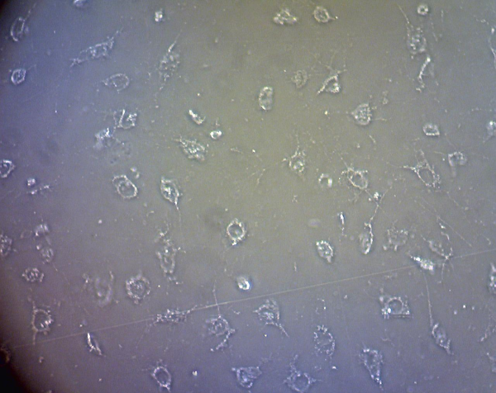
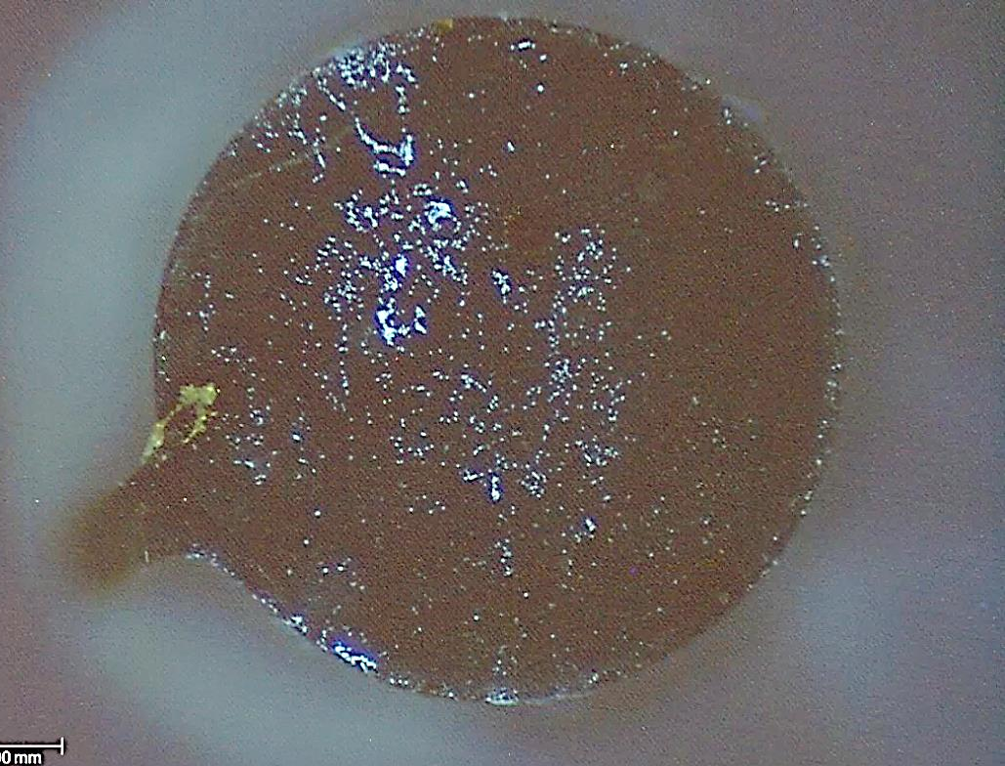
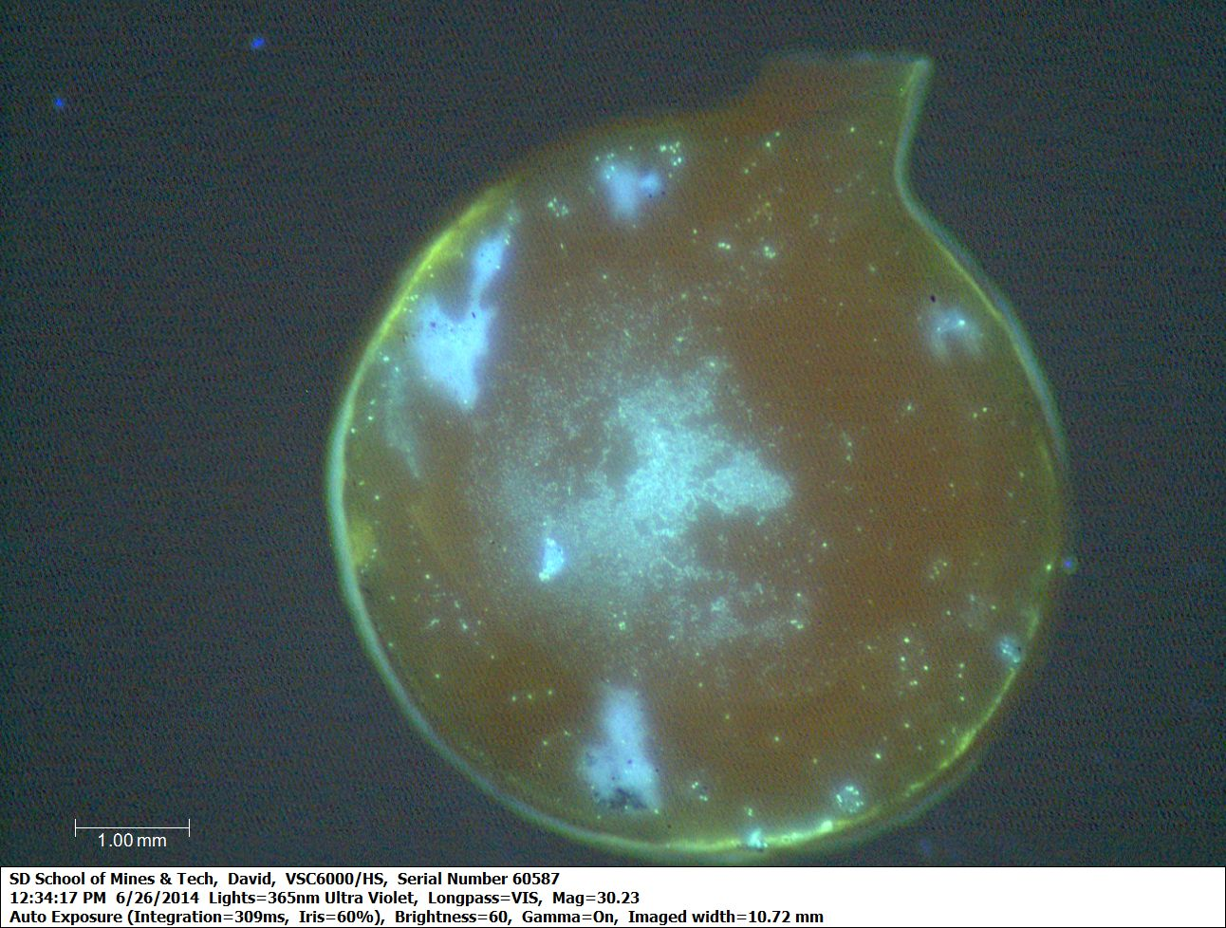
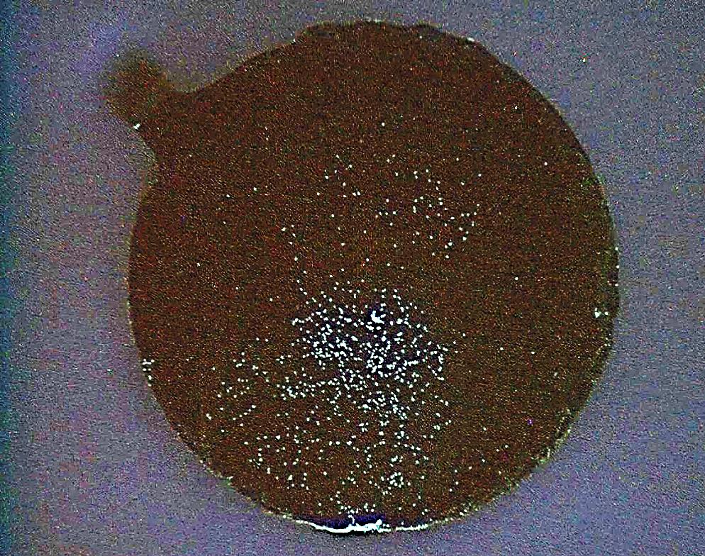
Cytotoxicity Testing of Solid BAM & BAM+TiB₂ For Load Bearing Implants Jordyn Surber, University of Wyoming
Faculty Advisors: Dr. Grant Crawford; Dr. M. West Dr. A. Boysen
Introduction
Procedure & Results
An increase of active lifestyles has created a demand for more efficient, longer lasting, and more cost effective load bearing implants. Load bearing implants currently have a lifetime of 10-15 years and the cost of replacement is expensive. Researchers are looking for a biocompatible, cheap, smooth, and durable material to coat the implants. An implant coating would increase the longevity and lifetime while decreasing the demand for costly replacement surgeries.
Experimental Overview
Contact angle measurement
Cell culture -Mice osteoblasts (bone cells)
Microscope Evaluation (Optical microscopy)
Conduct MTT & Hoechst test
Introduction to BAM
Day 1
Prepare growth media
Day 2
Sonicate/Sterilize samples
Day 3
Perform standard cytotoxicity testing (Hoechst or MTT)
Add media to cells
Seed cells to 24-well micro plate (1x10⁵ cells/well)
Incubate at 37°C for 24 hours.
Add samples to individual wells
Incubate at 37°C for 24 hours.
200 µm
Hoechst MTT
Cells are added to sample
Fluorescent imaging
Visual cell count
Direct contact test
Cell culturing
Nationally accepted
Samples are added to cells
Optical microscopy
Absorbance reading
Micro plate reader
Introduction to BAM
Figure 4 : Set up under the hood vent in the lab following cell counting procedures.
Figure 3: General cell culturing procedure
Developed by Ames National Laboratory
Very low coefficient of friction~0.02
Extremely high hardness 32-35 GPa hardness, 35-46 GPa when combined with TiB₂
3rd strongest material behind industrial diamonds & cubic boron nitride (BN)
Density lower than Steel
Cheap to manufacture
Figure 2: Venn diagram of Hoechst vs. MTT testing
Optical Microscopy
MTT Absorbance Test
(7a)
(7b)
Figure 7a: BAM+TiB₂ Figure 7b: BAM
Figure 7c: Alumina Figure 7d: SDS
Cells in BAM+TiB2, BAM, and Alumina wells were alive and healthy throughout the well, including areas in close proximity to the solid samples. No signs of cytotoxic response are present.
The positive control solution killed nearly all of the cells, showing an obvious cytotoxic response to the SDS powder.
200 µm
Aluminum
Magnesium
Boride
200 µm
200 µm
(7c)
(7d)
200 µm
200 µm
Hoechst, Fluorescent Imaging
Figure 1: Crystal structure of AlMgB¹⁴ projection on the ab plane. Image from http://wiredspace.wits.ac.za/bitstream/handle/10539/167/02chapter2.pdf?sequence=3
Figure 8: Solid BAM during 48 hour Hoechst test. Figure 9: Ceramic Alumina (negative control) during 48 hour Hoechst test.
Figure 10: Solid BAM+TiB₂ during 48 hour Hoechst test
Figures 5 and 6 show absorbance readings taken from the 1st of the MTT tests. Generally, an absorbance over 0.3 is accepted as biocompatible. Tests were ran with triplicates.
Conclusion
Figure 8
Figure 9
Figure 10
Both the Hoechst and the MTT tests showed cells living on and around both of the BAM samples. This leads us to believe that BAM does not exhibit a cytotoxic response and may be a suitable candidate for medical implant coating applications.
Figures 10-12: Neon specks represent live cells living on the samples.
Future Work
Acknowledgements:
This work was made possible by the National Science Foundation REU Back to the Future Site. A special thank you to Dr. Grant Crawford and Dr. Michael West for all of their guidance throughout this research, and Dr. Alfred Boysen for his help in putting all of my research together. Also, a special thank you to Matthew Little for his help with cell culturing and in vitro testing.
Tests on different cell types, i.e. tissue cells or human osteoblasts
BAM coating of different implant types
Wear analysis of BAM coatings
Long term MTT testing (30-60 days)

